Slide 1
Introduction to Management

Slide 2
Introduction
Defined
Characteristics
Functional areas

Slide 3
Functional Concepts (Management Process)
Henry Fayol
Lyndall Urwick
L . Gullick
Forecasting and Planning.
Organising
Commanding
Co-ordinating
Controlling
Forecast
Planning
Organising
Commanding
Co-ordinating
Controlling
P Planning
O Organising
S Staffing
D Directing
Co Co-ordinating
R Reporting
B Budgeting

Slide 4

Planning
the basic managerial function
helps in determining the course of action
Involves in the selection of organizational objectives, developing policies, procedures, programs, budgets and strategies

Slide 5

Organising
arrange, guide, coordinate, direct and control the activities of 5Ms
Steps
To identify the work
To classify
To Assign
To delegate
To Coordinate

Slide 6

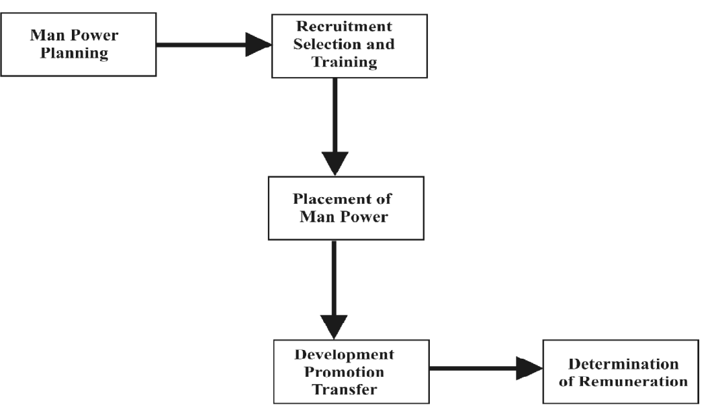
Staffing
Defining work force requirements, appraising, selecting, compensating and training

Slide 7

Directing
moving to action and supplying simulative power to the group
It is the final action of the manager in getting others to act
(a) Leading (b) Communication (c) Motivation (d) Supervision

Slide 8

Coordination
channelise the activities of various individuals in the organisation
according to predetermined targets and corrective measures

Slide 9
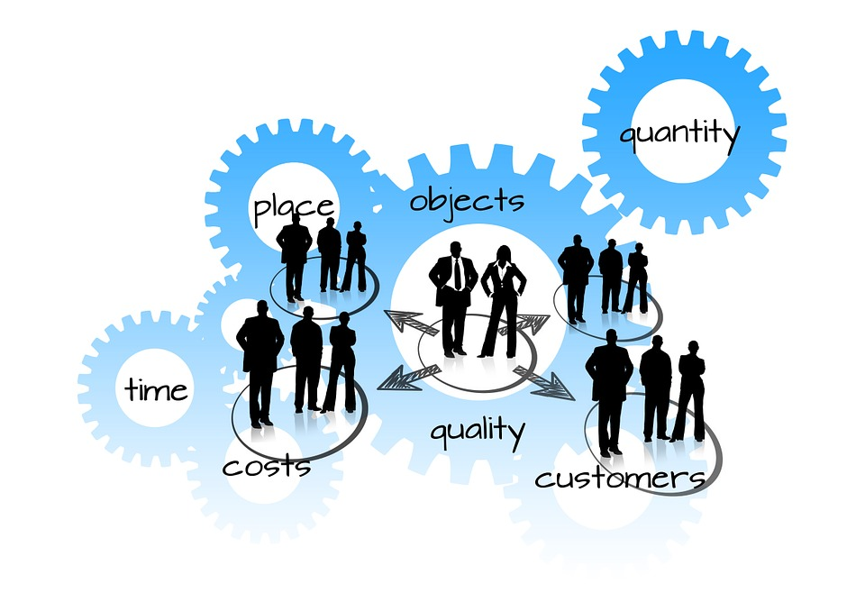
Controlling
ensuring that the organization is moving in the desired direction
Steps
Establishing standard
Measurement of actual performance
Finding the variance
Taking corrective actions.

Slide 10
Is management
Art, Science or Profession?

Slide 11
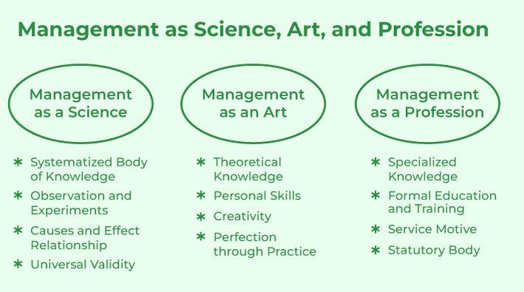

Slide 12
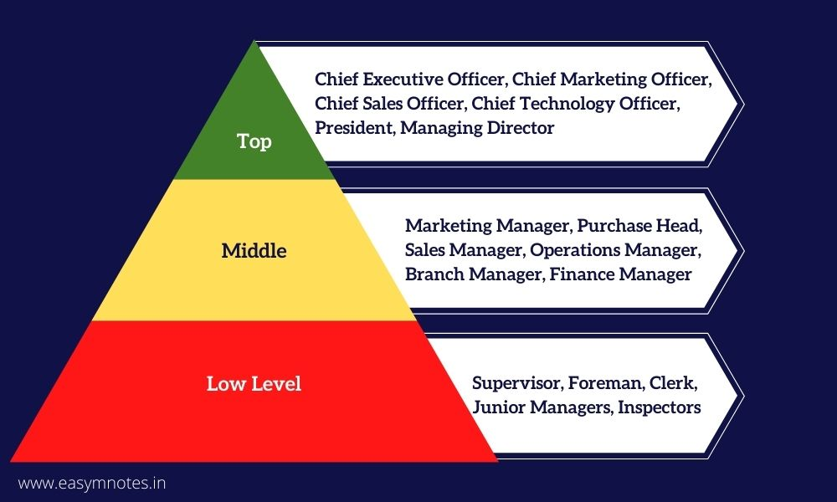
Levels of Organization

Slide 13
Administration
Management
Thinking function
Formation of objectives , plans and policies
Top level management function
Makes major policy decision
Decisions are influenced by external factors such as social, political and legal
Often associated with government policies
Doing Function
Getting things done through other people
Lower level management function
Within the framework of administration
Influenced by internal factors such as values, beliefs and opinions
Widely used in the business world

Slide 14

Technical
Human
Analytical
Conceptual
Communication Decision-making
Skills

Slide 15

Interpersonal Relationship
As a Figure head.
Leadership role.
Liaison officer.
Roles

Slide 16
Information processing
Monitoring Information
Disseminating Information.
Organisations Spokesman.
Roles

Slide 17
Decision Making
As an Entrepreneur
As a Conflict Handler
As a Resource Allocator
As a Negotiator
Roles

Slide 18

A manager is not a person who can do the work better than his men;
he is a person who can get his men to do the work better than he can. – Frederick W. Smith
Challenges

Slide 19
Getting to know your team and their concerns
Being a constant source of motivation
team conflicts
Employee training
Preventing brain drain
Leading former peers
Changes in Workforce
Decision making process
Challenges

Slide 20
Challenges
Attracting Talents
Performance Management
Internationalisation of business
Competitive advantage
Development of environment
Technological change

